Slide 1
ENHANCING HOME AUTOMATION WITH IOT GATEWAYS

Slide 2
What is IOT
The Internet of Things is the network of physical objects or "things" embedded with electronics, software, sensors, and network connectivity, which enables these objects to collect and exchange data.
It allows objects to be sensed and controlled remotely across existing network infrastructure, creating opportunities for more direct integration between the physical world and computer-based systems, and resulting in improved efficiency, accuracy and economic benefits.
These devices collect useful data with the help of various existing technologies and then autonomously flow the data between other devices

Slide 3
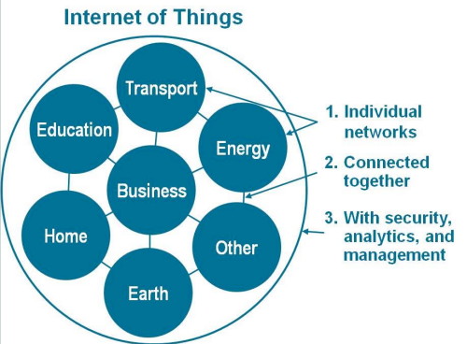
IoT as a Network of Networks
These networks connected with added security, analytics, and management capabilities. This will allow IoT to become even more powerful in what it can help people achieve.

Slide 4
Few Applications of IoT
Building and Home automation
Manufacturing
Medical and Healthcare systems
Media
Environmental monitoring
Infrastructure management
Energy management
Transportation
Better quality of life for elderly

Slide 5
OBJECTIVE
IoT is an upcoming technology that allows to control hardware devices through the internet and simplify use of technology.
Here we propose to use IoT in order to control home appliances, thus automating modern homes through the internet.
The internet of things (IoT) is the internetworking of physical devices, vehicles, buildings an other items – embedded with electronics, software, sensors, acutators and network connectivity that enable these objects to collect and exchange data.

Slide 6
MOTIVATION
Nowadays office and building automation systems are used more and more. On the hand, they provide increased comfort, results in a smarter home and is used to provide a higher and heathier standard of living.
On the other hand automation systems installed in commercial buildings don’t only increase comfort, but also allow centralized control of heating, ventilations, air condition and lighting.
Hence, they contribute to an overall cost reduction and also to reduction and also to energy saving while we are not able to access them physically.

Slide 7
THANK YOU…….!!!

